Slide 1
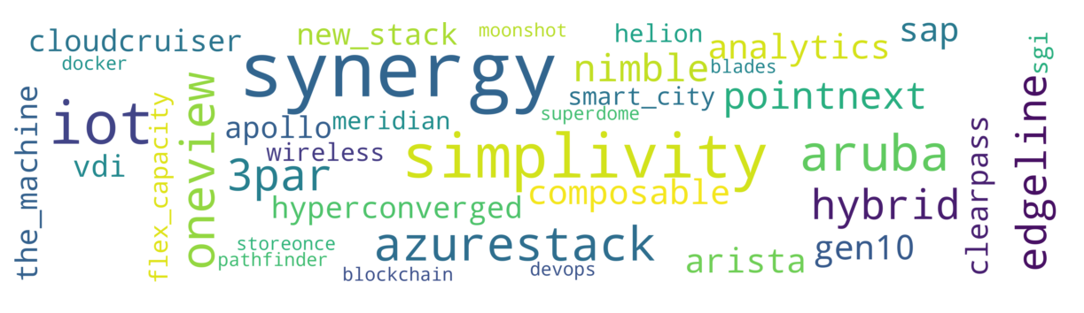
FlexCapacity
Cloud
AzureStack
Storage
Aruba
IoT
OneView
Synergy
Nimble
Networking
HPE Pointnext
ClearPass
SecuritySolutions
Analytics
Composable
SimpliVity
Edge
Gen10
Meridian
Hyperconverged
TheMachine

